Slide 1

ABE 715
Computer Programming
Lecture 4: Loops & Iteration
The "While" and "For" Loops
Dr. Kadeghe G. Fue
Department of Agricultural Engineering
1

Slide 2
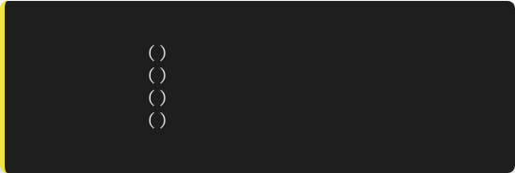
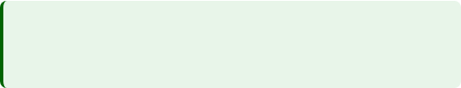
Recap: Control Flow
Last lecture, we discussed Conditionals (If/Else).
# We don't want to write this:
These allow our code to make a single decision based on the state of the system.
check_sensor
check_sensor
check_sensor
check_sensor
# ... 996 more times ...
But what if we need to do something 1,000 times? Or keep doing it until a tank is full?
2

Slide 3

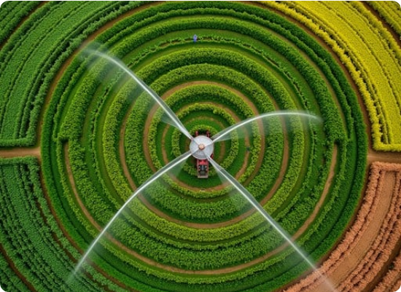
The Power of Iteration
Why Loop?
In Engineering, tasks are rarely singular. We deal with:
•
Time Series: 24 hours of temp data.
•
Spatial Grids: 100 soil samples across a field.
•
Continuous Monitoring: Checking a water level sensor every second.
Loops allow us to repeat a block of code efficiently.
3

Slide 4
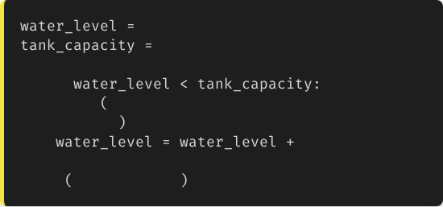
The while Loop
"Keep going until..."
0
The while loop runs as long as a condition is True.
100
It is perfect for situations where you don't know exactly how many times you need to loop, but you know the stop condition.
while
print
f"Level: {water_level}. Pumping...”)
10
print
"Tank Full!"
Example: Filling a tank.
4

Slide 5
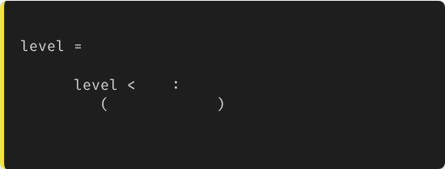
Warning: Infinite Loops
Danger Zone
# BAD CODE - DO NOT RUN
If the condition never becomes False, the program will run forever (or until your computer freezes).
0
while
100
print
"Filling..."
Common Mistake: Forgetting to update the variable that controls the loop.
# We forgot to add water!
# level stays 0 forever.
5

Slide 6
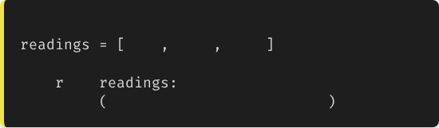
The for Loop
"For every item in..."
The for loop is used when you want to iterate over a sequence (like a list of data) or a specific range of numbers.
# Iterating a sequence
22.5
23.1
21.8
for
in
print
f"Analyzing reading: {r}"
It is the most common loop in data analysis.
6

Slide 7
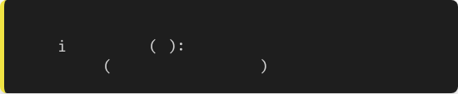
The range() Function
Often we just need to loop a specific number of times (e.g., 5 times).
range(n) generates numbers from 0 up to (but not including) n.
# Repeat 5 times
for
in
range
5
print
f"Sample #{i+1}"
•
range(5) → 0, 1, 2, 3, 4
•
range(1, 4) → 1, 2, 3
7

Slide 8
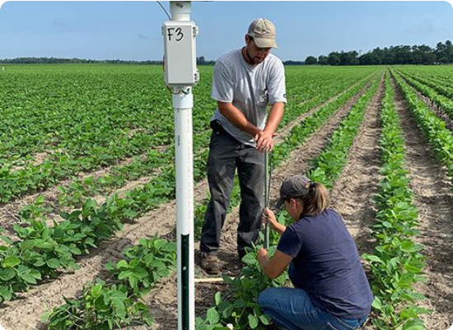
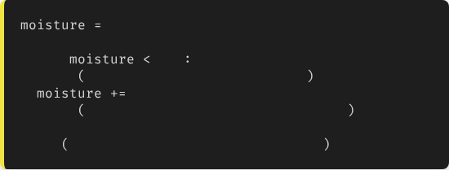
Example 1: Sensor Polling
Monitoring until Saturation
We want to irrigate until the soil moisture reaches 100%.
40
# Initial %
while
100
print
"Valve OPEN. Irrigating..."
20
# Simulating water add
print
f"Current Moisture: {moisture}%"
print
"Target Reached. Valve CLOSED."
8

Slide 9
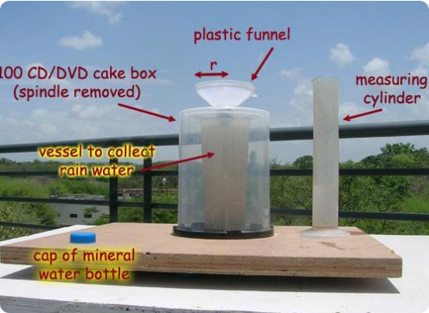
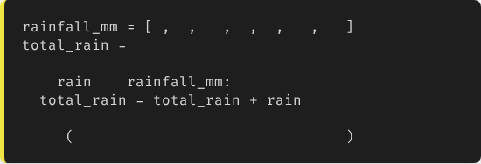
Example 2: Data Aggregation
Summing Daily Rainfall
We have a list of rainfall (mm) for the past week. We need the total.
0
5
12
0
2
45
10
0
for
in
print
f"Weekly Total: {total_rain}mm"
9

Slide 10
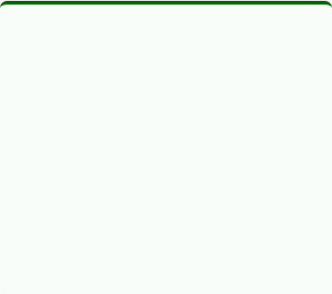
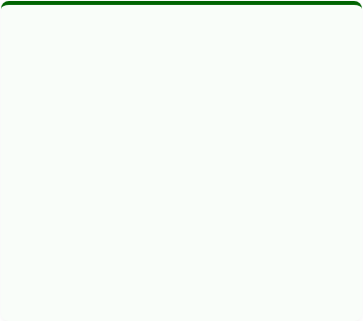


Loop Control: Break & Continue
Break
Continue
Pass
Immediately exits the loop entirely.
Skips the current iteration and jumps to the next one.
Does nothing. Used as a placeholder in empty code blocks.
Use case: Emergency Stop if a sensor detects a leak.
Use case: Skip processing if data is missing (-1).
10

Slide 11
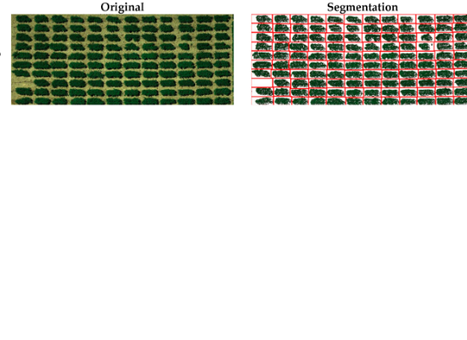
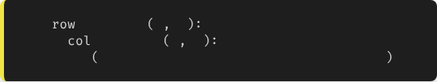
Nested Loops
Working with Grids
If we have a grid of sensors (Rows and Columns), we put a loop inside a loop.
for
in
range
1
4
for
in
range
1
4
print
f"Checking Sensor at R{row}, C{col}"
11

Slide 12
Best Practices
•
Prefer for over while: If you are iterating over a known sequence, for is safer (no infinite loops) and easier to read.
•
Meaningful Variable Names: Don't just use i if you can use sensor_id or day.
for day in week: vs for i in x:
•
Watch Off-By-One Errors: Remember that range(5) stops at 4, not 5.
12

Slide 13
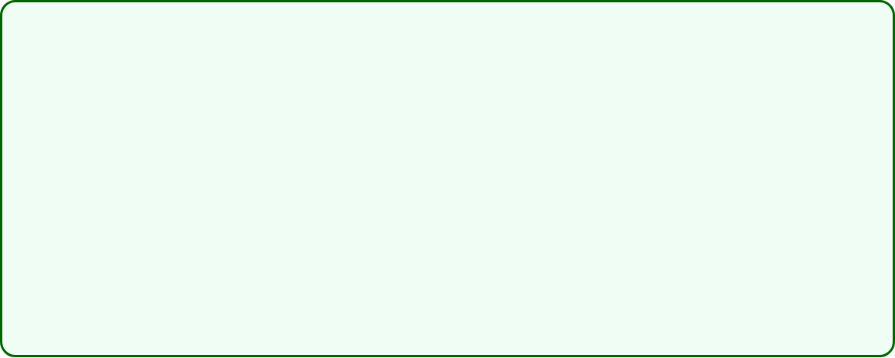
Lecture 4: Take-Home Assignment
Soil Data Analysis Script
Scenario: You have a list of 10 soil moisture readings collected by a drone.
data = [45, 50, 20, 15, 55, 60, 10, 25, 30, 48]
Task: Write a Python script that:
1.
Uses a for loop to calculate the average moisture.
2.
Uses another loop to count how many readings are critically dry (below 20).
3.
Prints the Average and the Count of dry spots.
13

Slide 14
Questions?
Next Class: Data Structures (Lists & Dictionaries)
Dr. Kadeghe G. Fue
Department of Agricultural Engineering
14

